Slide 1
How to handle of restricted area parcel
작성일자 : 2015-03-13
상황관리팀 Dean.Hwang

Slide 2
Outline
<Object>
How to handle of restricted area parcel

Slide 3
SG Restricted area Mgt.
SG Restricted area process flow chart
Destination DPC
DPC2-IN update
Restricted area parcel
Check and hold in DPC
Restricted area mgt handle of this postal code
Auto notice
Email to buyer
No email address
Contact buyer
to get
Email address
No answer
Return to seller or
Self collection
Yes
Yes
The buyer send to
Alternative address
SCM team fix address
And inform to SG DPC
Each SG OPS admin
Arrange to delivery
Delivered

Slide 4
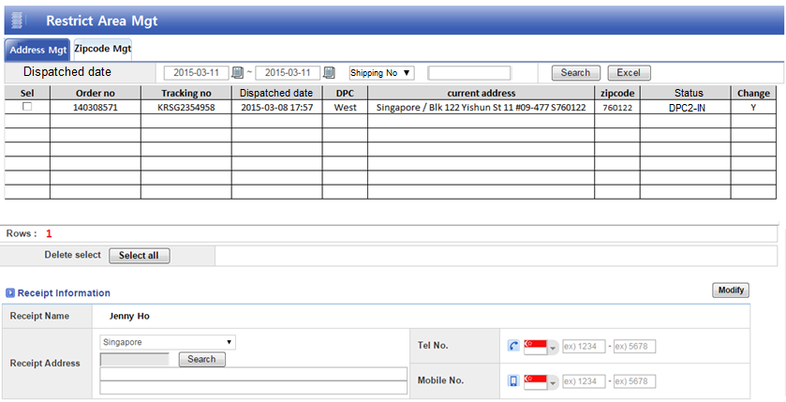
SG Restricted area Mgt
QSM menu path : Policy>>>> SG Restricted area Mgt.
Based on dispatched restricted area in- housed parcel, you can search each day and modify alternative address.

Slide 5
SG Restricted area Mgt.
QSM menu path : Policy>>>> SG Restricted area Mgt.
When you press “Search” button, you can see the postal search code popup.

Slide 6
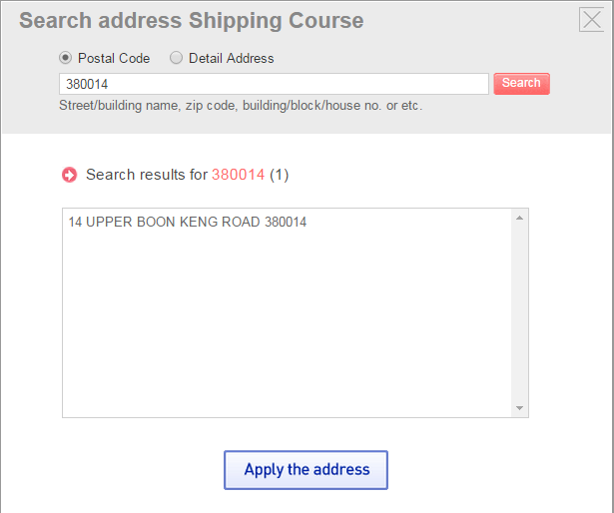
SG Restricted area Mgt
QSM menu path : Policy>>>> SG Restricted area Mgt.
When you input correct postal code in popup, you can see detail address and you should press “apply the address "button.

Slide 7
SG Restricted area Mgt.
QSM menu path : Policy>>>> SG Restricted area Mgt.
If you input correct postal code, you should fill out rest of detail address and press modify button. It will change new address.

Slide 8
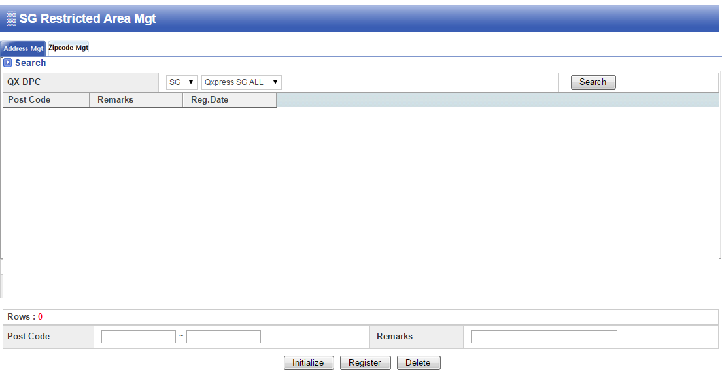
SG Restricted area Mgt.
QSM menu path : Policy>>>> SG Restricted area Mgt.
When SG team inform to QX technical team, We will input restricted area postal code from this function. It will show restricted area
Way bill. This function can register that area postal code and delete.

Slide 9

SG Restricted area Mgt.
E-mail form: Notice email for restricted area (to buyer)
Title: [SGSG123456] Delivery can’t be possible due to the restricted area
Dear Customer
Thanks for using Qxpress.
We can’t deliver your parcel because your shipping address has been confirmed as restricted area for delivery
Your Shipping information is ;
Please reply to us for your alternative address to be deliverable.
Your cooperation is greatly appreciated.
The Customer Service Center of Qxpress

